Slide 1
Normalization

Slide 2
Data base anomalies
1. Update
2. Insert
3 Delete anomalies

Slide 3
Empno | Projno | Ename | Pname | No_hours
E1 | P11 | A | Adv | 11
E2 | P10 | B | Billing | 12
E6 | P10 | C | Billing | 15
E3 | P12 | D | Seals | 20
E5 | P10 | E | Billing | 10
Update P10—Billing to accounting
Can not insert new project without assigning employees
Deletion P12 – losing detail of employee D

Slide 4
Normalization
Is a technique for designing relational database tables to minimize duplication of information and to increase the logical consistency.

Slide 5
Dependencies
Functional dependency
Full functional dependency
Partial functional dependency
Transitive functional dependency
Multi-valued functional dependency
Join functional dependency

Slide 6
Functional dependency
A B
A-determinant
B-determined
Attribute B has a functional Dependency on Attribute A, If for each value of attribute A, there is exactly one value of Attribute B.
Part_name | Cost
Hard disk | 1500
Pen drive | 700
Hard disk | 1500
CD | 10
Pen drive | 700

Slide 7
Full functional dependency
An attribute is FFD on a set of attributes if
  It is functionally dependent on S and
  Not functionally dependent on any proper subset of S.

Slide 8
Roll_num | NAme | Course_id | course_title | Grade
1 | Raj | CSE301 | DBMS | A
1 | Raj | CSE306 | NW | C
2 | Ankur | CSE301 | DBMS | B
2 | Ankur | CSE306 | NW | A
3 | Arun | CSE316 | SOFT ENGG | C
roll_num ,course_id Grade
Name and course_title are not fully functional dependent on composite key

Slide 9
Partial dependency
The value of one attribute is dependent on another attribute of relation which is a part of composite key.
Name is partially dependent on roll number.

Slide 10
Transitive functional dependency
Dept_id | Dept_name | Hod_name
1 | CSE | Mr X
2 | IT | Mr Y
3 | ECE | Mr z
4 | ME | Mr A
Dept_id Dept_name Hod_name
A B C

Slide 11
Multi-valued functional dependency
Name | Ph_number
Ram | 987217701
Sham | 982271661
Ram | 876622134
Rajesh | 872213477
Raj | 657932721
Ajay | 873539262
A B
Name Ph_number

Slide 12
Decomposition of tables
Lossy decomposition
Lossless decomposition

Slide 13
Model | Price | Make
N12 | 10000 | CANON
P20 | 12000 | NIKON
A73 | 15000 | CANON
price | make
10000 | CANON
12000 | NIKON
15000 | CANON
Model | Make
N12 | CANON
P20 | NIKON
A73 | CANON

Slide 14
model | price | make
N12 | 10000 | CANON
N12 | 15000 | CANON
P20 | 12000 | NIKON
A73 | 10000 | CANON
A73 | 15000 | CANON

Slide 15
Model | Price | Make
N12 | 10000 | CANON
P20 | 12000 | NIKON
A73 | 15000 | CANON
Model | Make
N12 | CANON
P20 | NIKON
A73 | CANON
price | make
10000 | CANON
12000 | NIKON
15000 | CANON
model | price | make
N12 | 10000 | CANON
N12 | 15000 | CANON
P20 | 12000 | NIKON
A73 | 10000 | CANON
A73 | 15000 | CANON

Slide 16
Properties of decomposition
Lossless
Dependency preserving

Slide 17
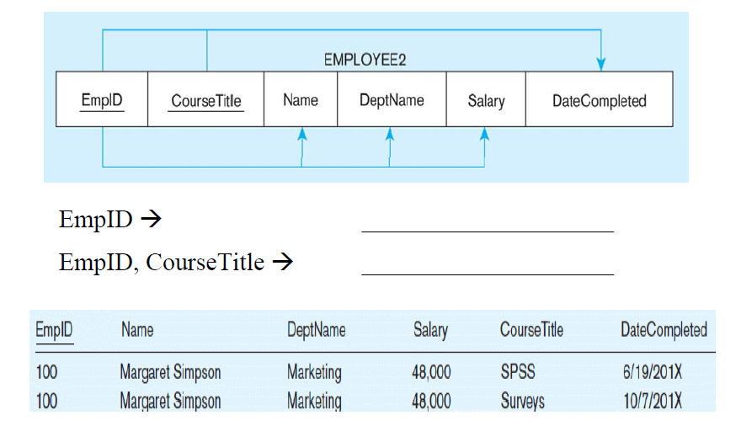
Functional dependency diagram

Slide 18
First Normal form
Relation said to be in first normal form if the value in the domain of each attribute are simple or atomic i.e. only one value is associated with each attribute and the value is not a set of values.

Slide 19
Faculty_name | Course_code
Harish | CSE310 CSE201 CSE303
Rajesh | INT306 INT202 CSE101
Raj | CSE202 CSE303 CSE306

Slide 20
Faculty_name | Course_code
Harish | CSE310
Harish | CSE201
Harish | CSE303
Rajesh | INT306
Rajesh | INT202
Rajesh | CSE101
Raj | CSE202
Raj | CSE303
Raj | CSE306

Slide 21
Second normal form
1. relation is in 1NF
2. all its non primary key attributes are fully functionally dependent on primary key

Slide 22
Lab_Course
Lab-course | Teacher | Lab-no | Lab-capacity
CSE301 | ANIL | 34-201 | 30
CSE304 | AMIT | 34-304 | 28
CSE316 | SUMIT | 34-402 | 32
CSE101 | NIKHIL | 34-404 | 30
CSE501 | RAHUL | 34-306 | 28
Lab-course--→ teacher
Lab –course-→ lab-no
Lab-course→ lab-capacity

Slide 23
Course_detail
Lab-course | Teacher | Lab-no
CSE301 | ANIL | 34-201
CSE304 | AMIT | 34-304
CSE316 | SUMIT | 34-402
CSE101 | NIKHIL | 34-404
CSE501 | RAHUL | 34-306
Lab-course→ teacher
Lab-course → lab-no

Slide 24
Lab_detail
Lab-no | Lab-capacity
34-201 | 30
34-304 | 28
34-402 | 32
34-404 | 30
34-306 | 28
Lab-no→ lab-capacity

Slide 25
3rd normal form
It is 2nf
All non primary attributes have no transitive dependency on primary key.

Slide 26
Students
Roll-no | Game | Fee
1 | Cricket | 200
2 | Tennis | 300
3 | Foot ball | 100
4 | Cricket | 200
5 | hockey | 150
Roll-no→game→fee
anomalies
Insert-------no new student added without assigning game
Update---- change in fee of cricket … needs to rows to be update
Delete----- student with roll no 2 is deleted then we loss the info regarding tennis game with its fee.

Slide 27
Student_Game
Roll-no | Game
1 | Cricket
2 | Tennis
3 | Foot ball
4 | hockey
Student_Fee
Game | Fee
Cricket | 200
Tennis | 300
Foot ball | 100
hockey | 150

Slide 28
BCNF
Boyce codd normal form
Improvement of 3NF
-If every determinant is a candidate key.
-Or table not have multiple overlapping candidate keys.
If a relation schema is in BCNF, then it also in 3NF. But a schema in 3NF may or may not be in BCNF. 3NF design always dependency Preserving and lossless, But it is very diffcult to achieve BCNF along with lossless join and dependency Persevering

Slide 29
ClientInterview
ClientNo | interviewDate | interviewTime | staffNo | roomNo
CR76 | 13-May-02 | 10.30 | SG5 | G101
CR76 | 14-May-02 | 12.00 | SG5 | G101
CR74 | 13-May-02 | 12.00 | SG37 | G102
CR56 | 1-Jul-02 | 10.30 | SG5 | G102
FD1 clientNo, interviewDate → interviewTime, staffNo, roomNo (Primary Key)
FD2 staffNo, interviewDate, interviewTime→ clientNo ,roomNo (Candidate key)
FD3 roomNo, interviewDate, interviewTime → clientNo, staffNo (Candidate key)
FD4 staffNo, interviewDate → roomNo, interviewTime
(Not valid Candidate key)
As a consequence the ClientInterview relation may suffer from update anomalies.
For example, two tuples have to be updated if the roomNo need be changed for staffNo SG5.

Slide 30
Example of BCNF(2)
To transform the ClientInterview relation to BCNF, we must remove the violating functional dependency by creating two new relations called Interview and StaffRoom as shown below,
Interview (clientNo, interviewDate, interviewTime, staffNo)
StaffRoom(staffNo, interviewDate, roomNo)
Interview
ClientNo | interviewDate | interviewTime | staffNo
CR76 | 13-May-02 | 10.30 | SG5
CR76 | 14-May-02 | 12.00 | SG5
CR74 | 13-May-02 | 12.00 | SG37
CR56 | 1-Jul-02 | 10.30 | SG5
StaffRoom
staffNo | interviewDate | roomNo
SG5 | 13-May-02 | G101
SG37 | 13-May-02 | G102
SG5 | 1-Jul-02 | G102
BCNF Interview and StaffRoom relations

Slide 31
4th NF
It is in BCNF
There is no multi value dependency in relation.
OR
There are multi value dependencies but the attributes which are multi value dependent on a specific attribute are dependent between themselves.

Slide 32
Case 1:- Assume there is no multi value dependency exists then, employee relation is in 4NF.
Case 2:- Assume the employee relation with multi value dependencies as shown
Emp_id->-> Language
Emp_id->-> Skill
Emp-id | Language | skill
101 | English | Teaching
101 | Hindi | Singing
101 | Punjabi | Conversation
202 | English | Singing
202 | Hindi | Teaching

Slide 33
Emp-id | Language | skill
101 | English | Teaching
101 | Hindi | Conversation
101 | English | Conversation
101 | hindi | Teaching
202 | English | Singing
202 | Hindi | Teaching
Multivalued dependencies exist
Emp-id→ → language
Emp-id→ → skill
Anomalies
Delete—if id 101 discontinues teaching skill … then two rows to be delete
Update– if id 101 change its skill teaching to singing … then number of changes to be done.

Slide 34
Emp-id | Language
101 | English
101 | Hindi
202 | English
202 | hindi
Emp-id | skills
101 | Teaching
101 | Conversation
202 | Singing
202 | Teaching

Slide 35
5th NF
A relation R is in Fifth Normal Form (5NF) if and only if the following conditions are satisfied simultaneously:
1. R is already in 4NF.
2. It cannot be further non-loss decomposed.

Slide 36
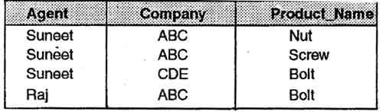
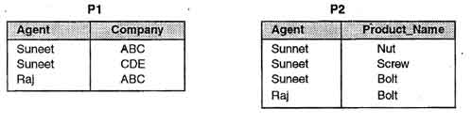

Slide 37
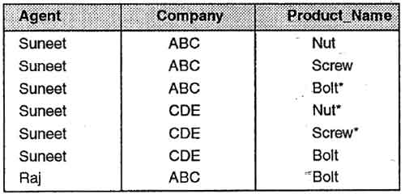

Slide 38
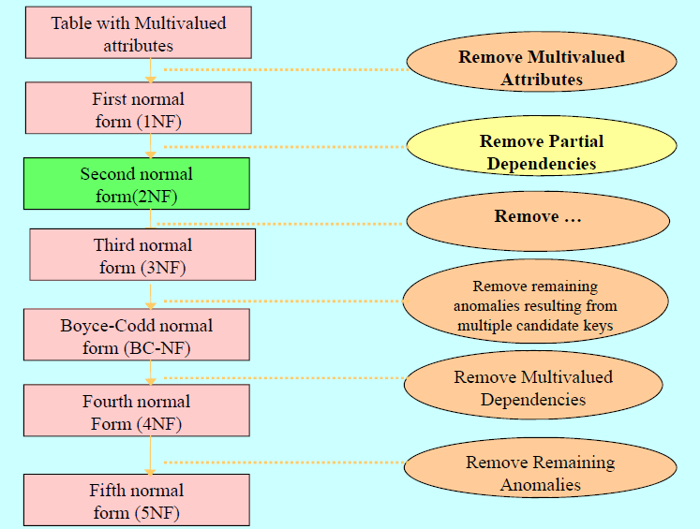
transitive dependencies

Slide 39
Dr. E. F. Codd's 12 rules
The rules mainly define what is required for a DBMS for it to be considered relational, i.e., an RDBMS.
Rule 0: Foundation Rule
A relational database management system should be capable of using its relational facilities (exclusively) to manage the database.

Slide 40
Rule 1: Information Rule
All information in the database is to be represented in one and only one way. This is achieved by values in column positions within rows of tables.

Slide 41
Rule 2: Guaranteed Access Rule
All data must be accessible with no ambiguity, that is, Each and every datum (atomic value) is guaranteed to be logically accessible by resorting to a combination of table name, primary key value and column name.

Slide 42
Rule 3: Systematic treatment of null values
Null values (distinct from empty character string or a string of blank characters and distinct from zero or any other number) are supported in the fully relational DBMS for representing missing information in a systematic way, independent of data type.

Slide 43
Rule 4: Dynamic On-line Catalog Based on the Relational Model
The database description is represented at the logical level in the same way as ordinary data, so authorized users can apply the same relational language to its interrogation as they apply to regular data. The authorized users can access the database structure by using common language i.e. SQL.

Slide 44
Rule 5: Comprehensive Data Sublanguage Rule
A relational system may support several languages and various modes of terminal use. And all of the following is comprehensible:
data definition
view definition
data manipulation (interactive and by program)
integrity constraints
authorization
Transaction boundaries (begin, commit, and rollback).

Slide 45
Rule 6: View Updating Rule
All views that are theoretically updateable are also updateable by the system.

Slide 46
Rule 7: High-level Insert, Update, and Delete
The system is able to insert, update and delete operations fully.
It can also perform the operations on multiple rows simultaneously.

Slide 47
Rule 8: Physical Data Independence
Application programs and terminal activities remain logically unimpaired whenever any changes are made in either storage representation or access methods.

Slide 48
Rule 9: Logical Data Independence
Application programs and terminal activities remain logically unimpaired when information preserving changes of any kind that theoretically permit unimpairment are made to the base tables.

Slide 49
Rule 10: Integrity Independence
Integrity constraints specific to a particular relational database must be definable in the relational data sublanguage and storable in the catalog, not in the application programs.

Slide 50
Rule 11: Distribution Independence
The data manipulation sublanguage of a relational DBMS must enable application programs and terminal activities to remain logically unimpaired whether and whenever data are physically centralized or distributed.

Slide 51
Rule 12: Non sub version Rule
If a relational system has or supports a low-level (single-record-at-a-time) language, that low-level language cannot be used to bypass the integrity rules or constraints expressed in the higher-level (multiple-records-at-a-time) relational language.

Slide 52
Based on these rules there is no fully relational database management system available today. In particular, rules 6, 9, 10, 11 and 12 are difficult to satisfy.

